Slide 1
Big Data With Hadoop
Project Submitted By
AKSHAYA D
NiiT TNAGAR Center CHENNAI

Slide 2


Slide 3
Agenda
Big Data Growth Drivers
What is Big Data?
Problem with Big Data
Hadoop-as-a solution
What is Hadoop
HDFS
YARN
MapReduce
Hadoop Ecosystem

Slide 4

Big Data Growth Driver

Slide 5
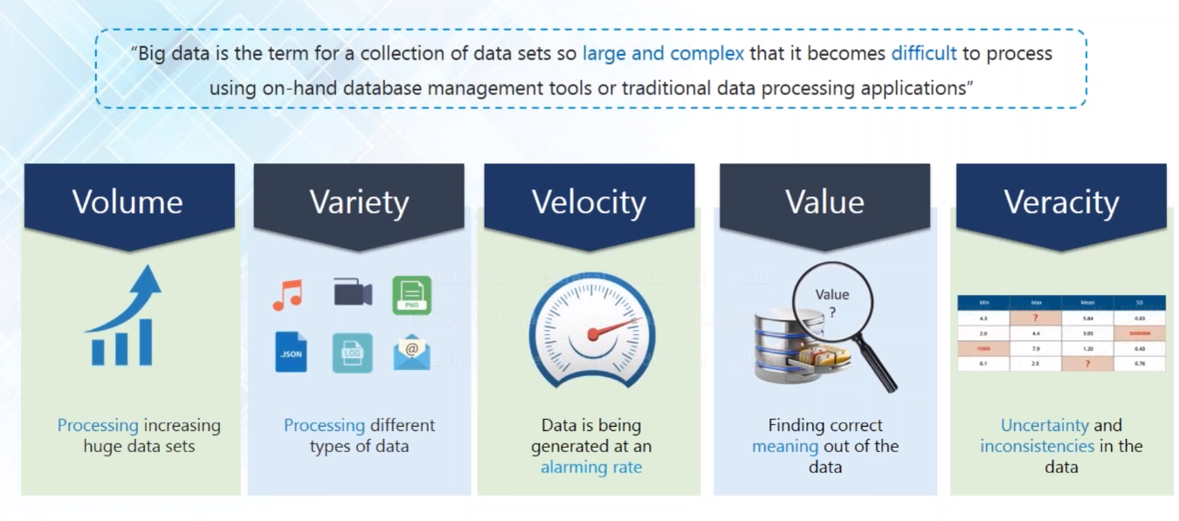
What is Big Data?

Slide 6
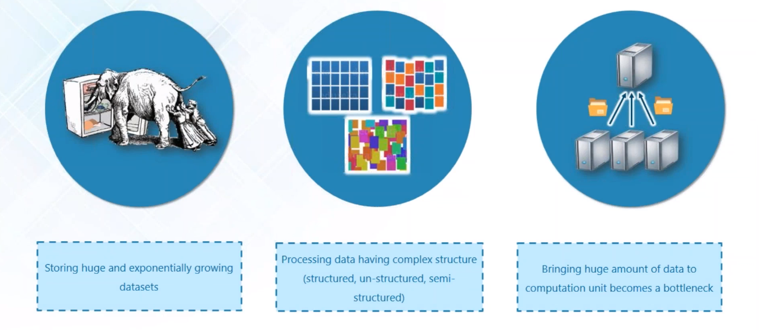
Problems with Big Data

Slide 7
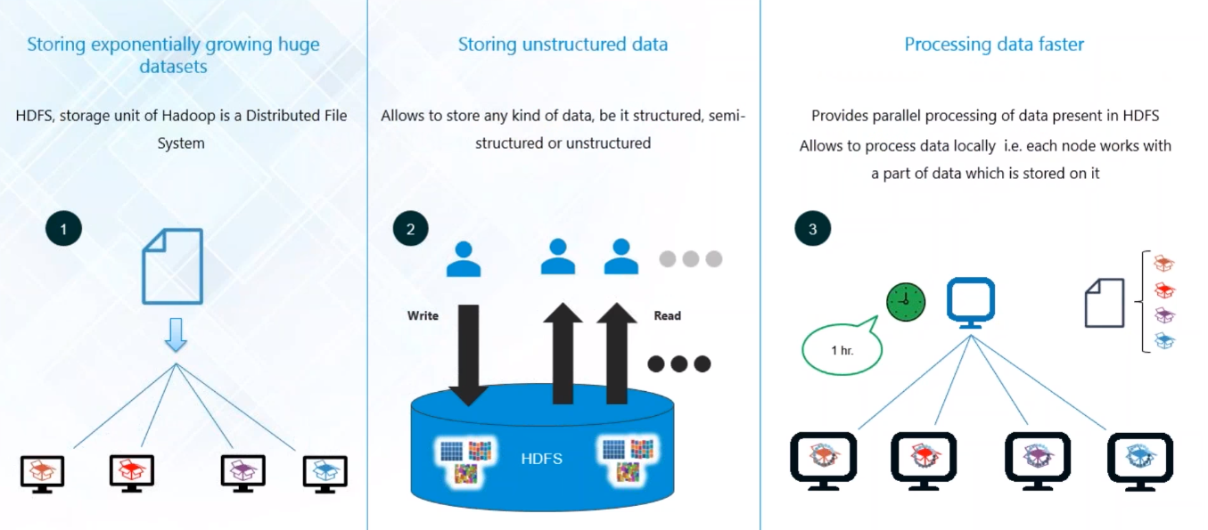
Hadoop-as-a Solution

Slide 8
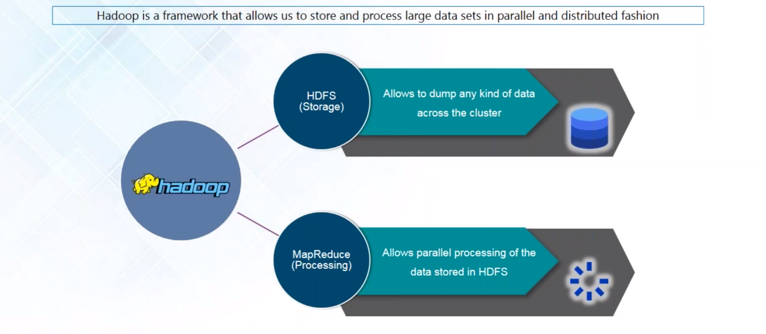
Hadoop

Slide 9
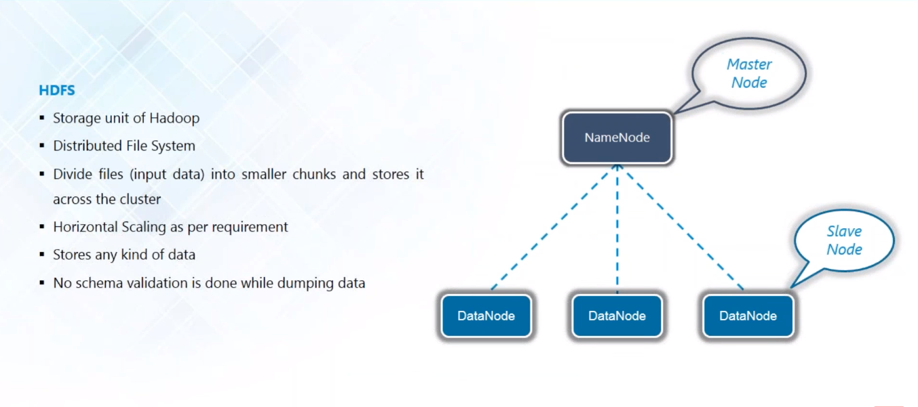
HDFS

Slide 10
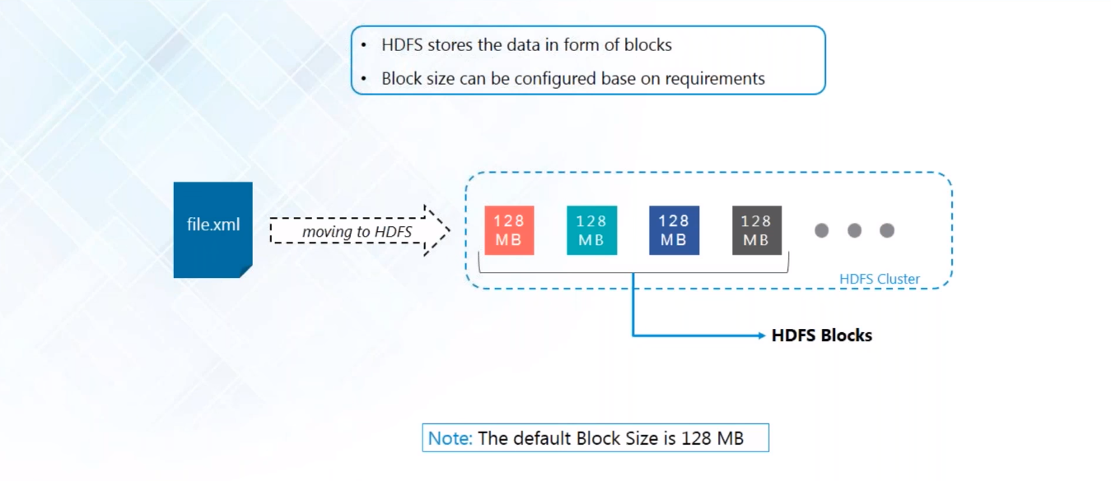
HDFS Block

Slide 11
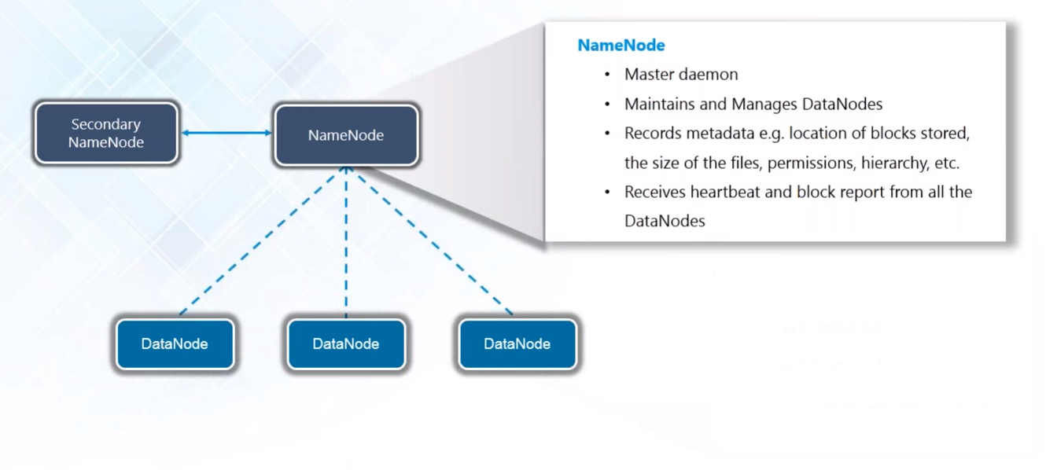
NameNode

Slide 12
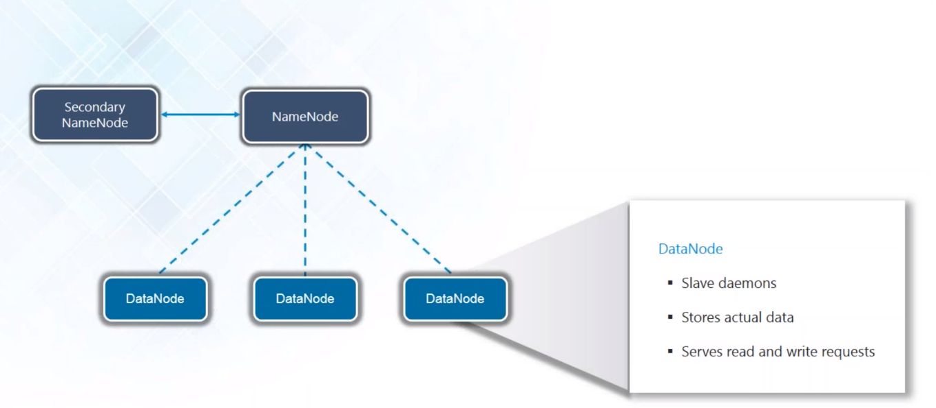
DataNode

Slide 13
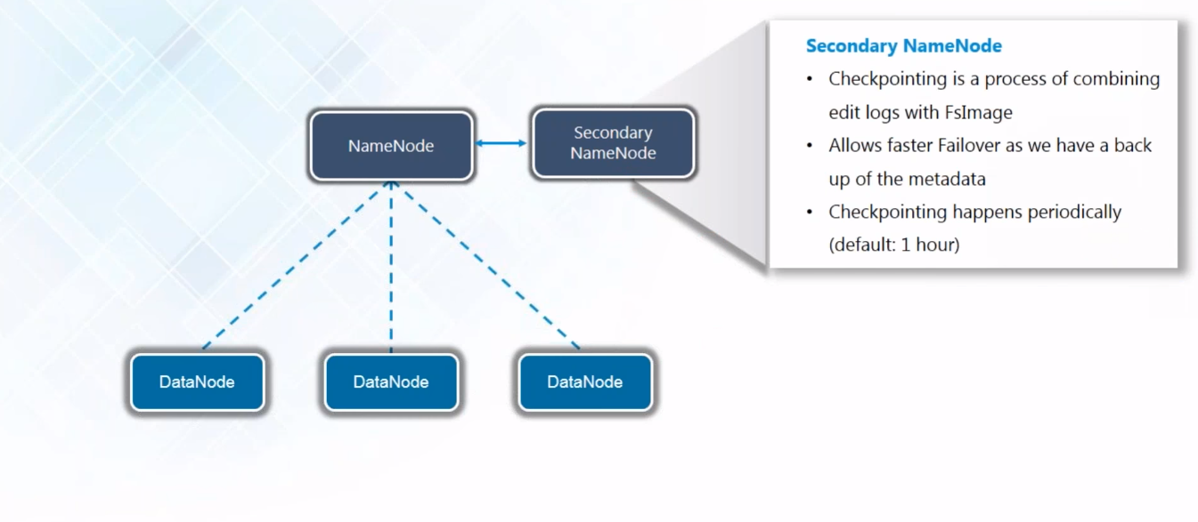
Secondary NameNode

Slide 14
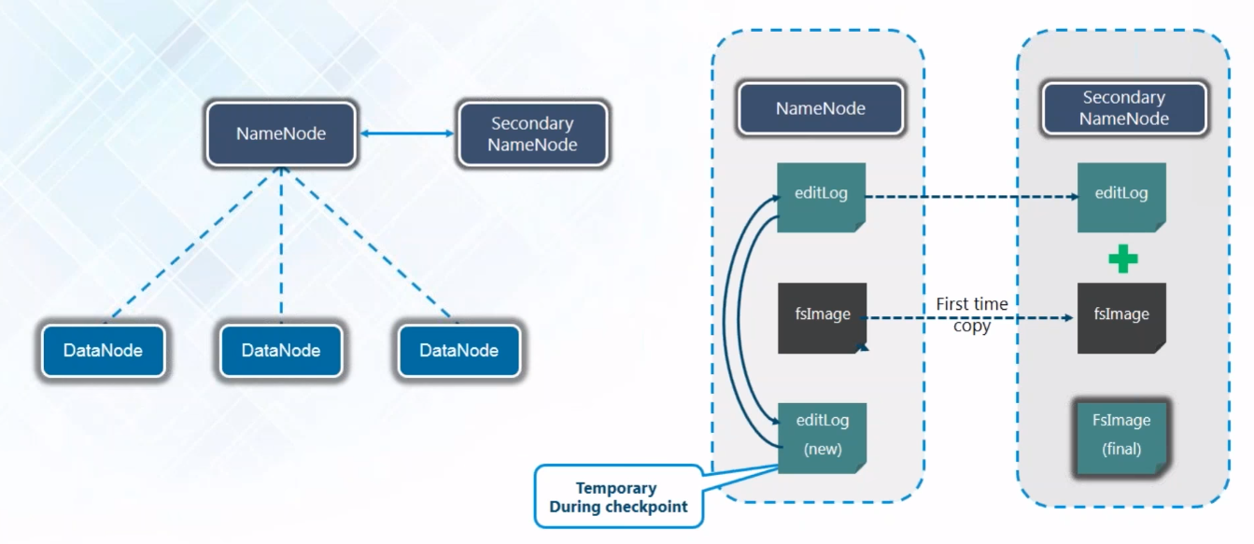
Hadoop Distributed File System

Slide 15
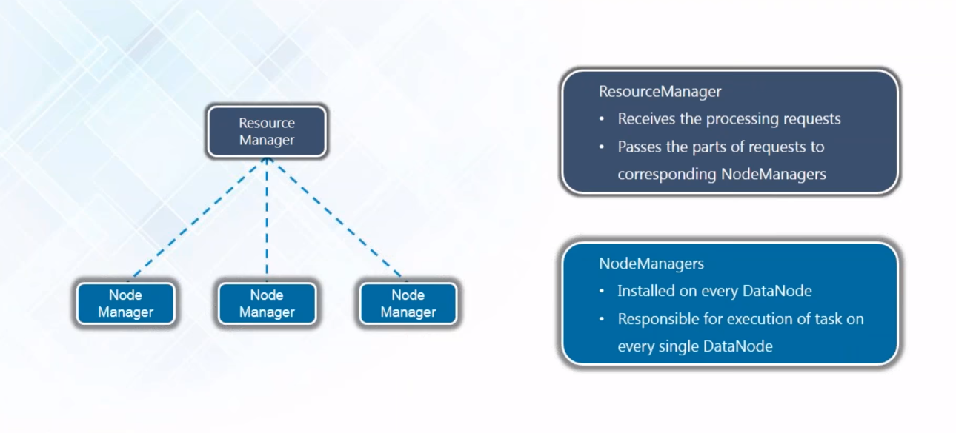
YARN

Slide 16
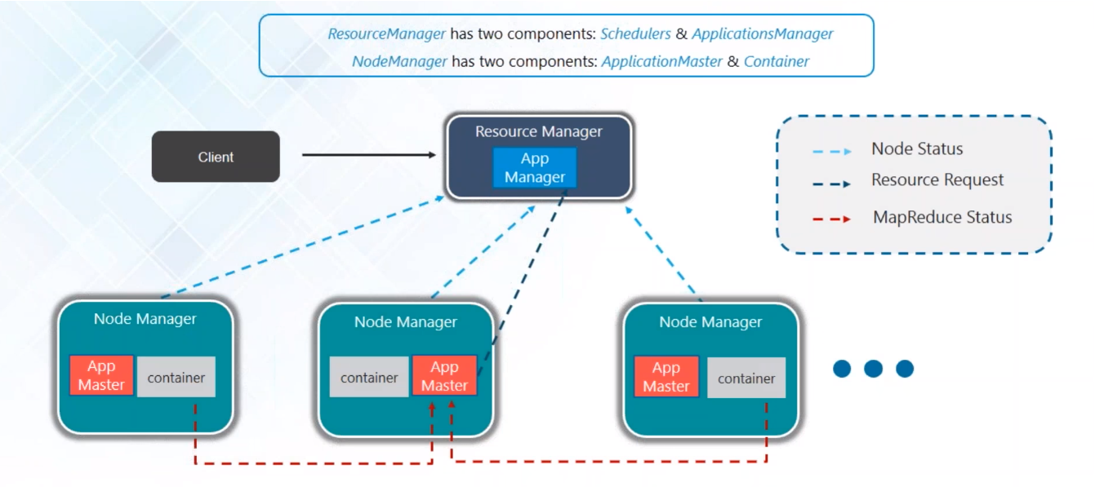
YARN Architecture

Slide 17
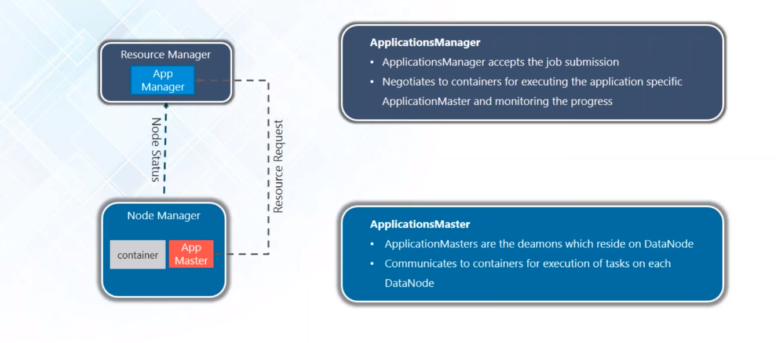
YARN Architecture

Slide 18
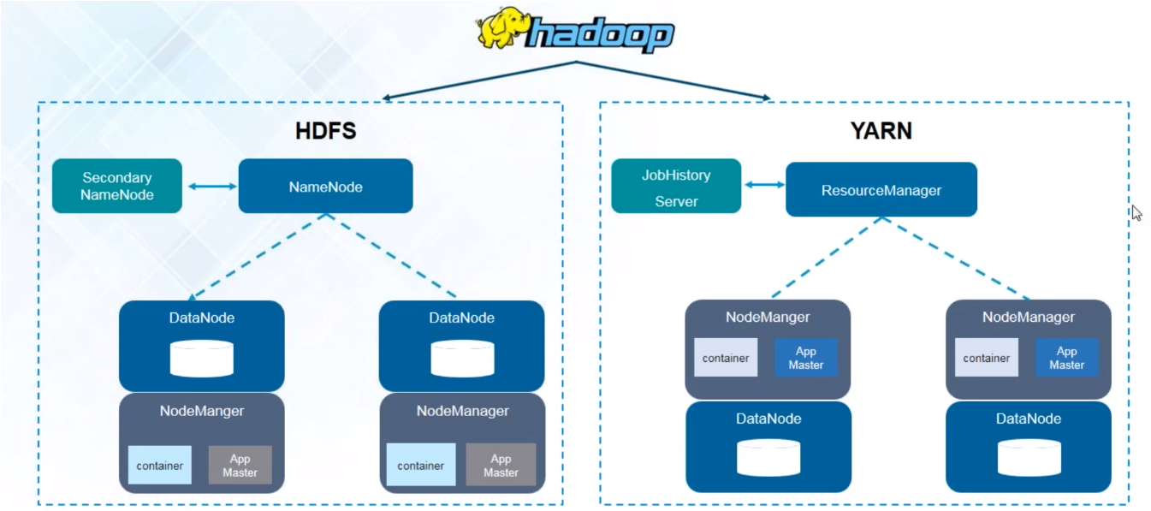
Hadoop Architecture

Slide 19
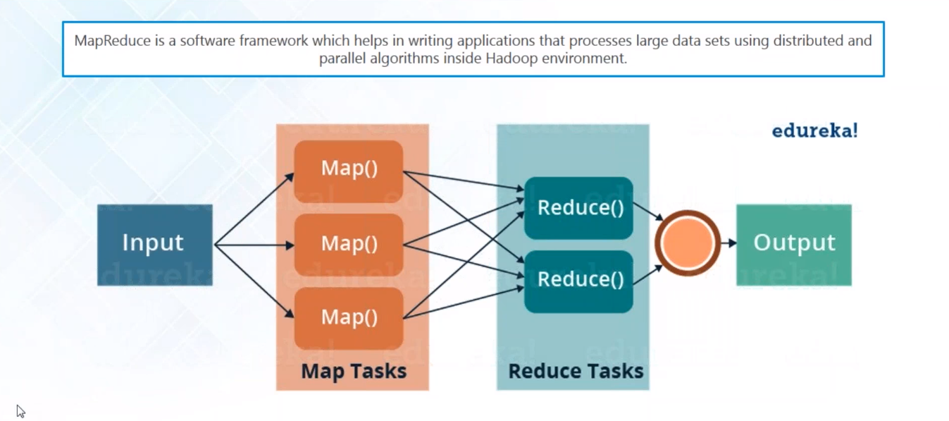
MapReduce

Slide 20
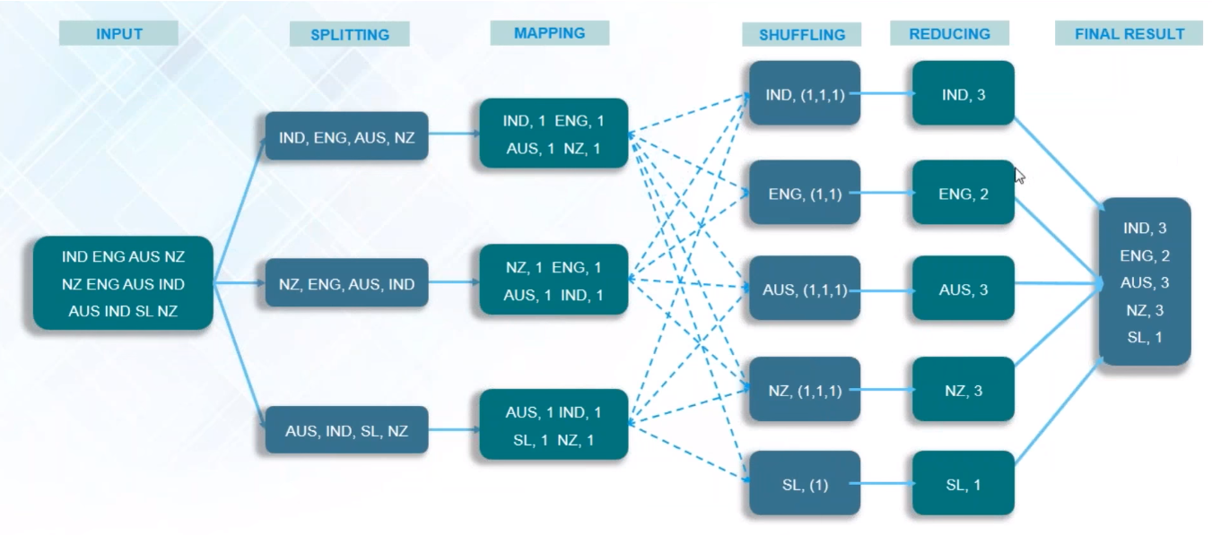
MapReduce Job Workflow

Slide 21
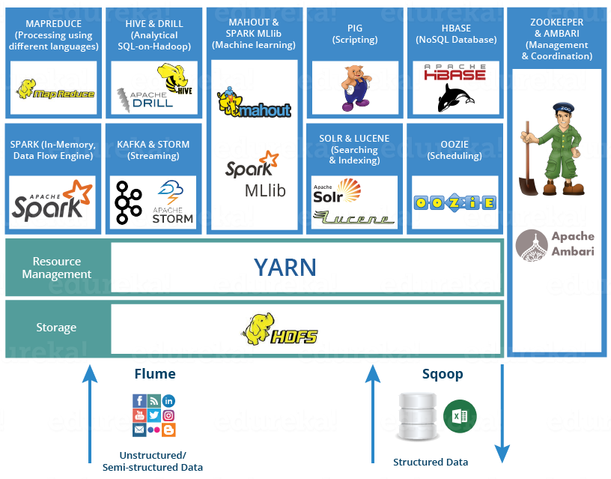
Hadoop Ecosystem

